Slide 1
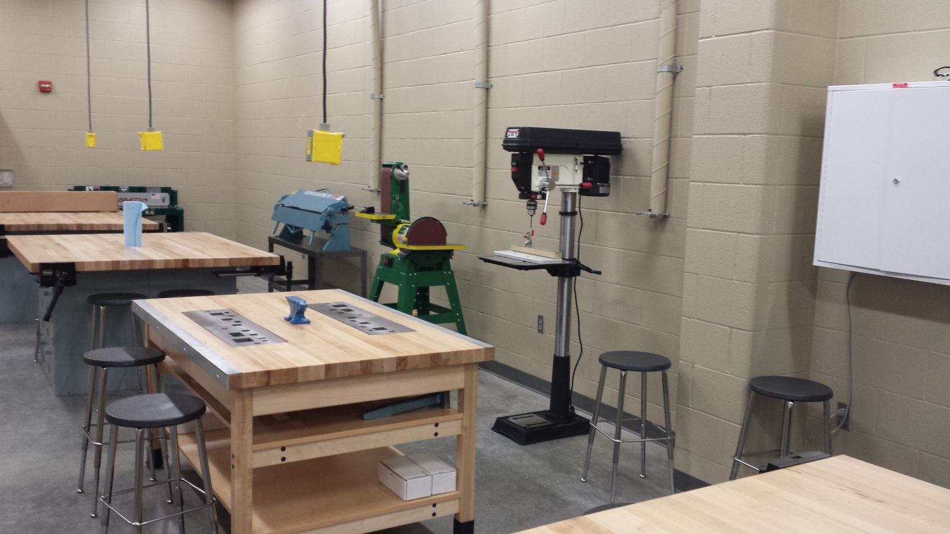
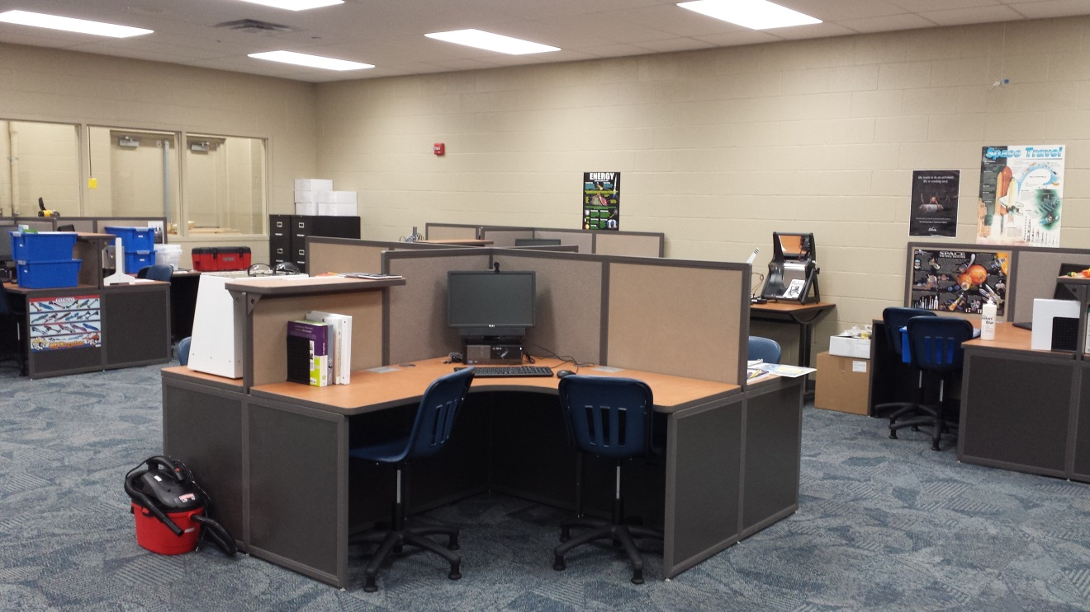
Welcome to Industrial Technology!
Mrs. Eker

Slide 2
Module Session (days)

Slide 10
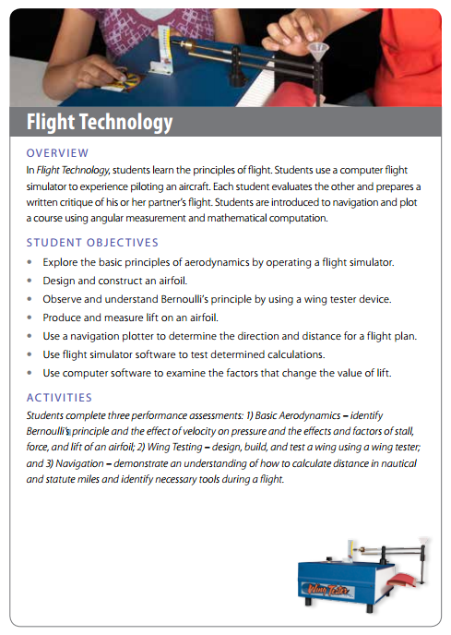

Slide 14
